Slide 1
Being kind to myself
Activity 4, SPHE Emotional Wellbeing, Unit 3
Emotional Wellbeing 3 | Activity 4, ‘Being kind to myself’

Slide 2
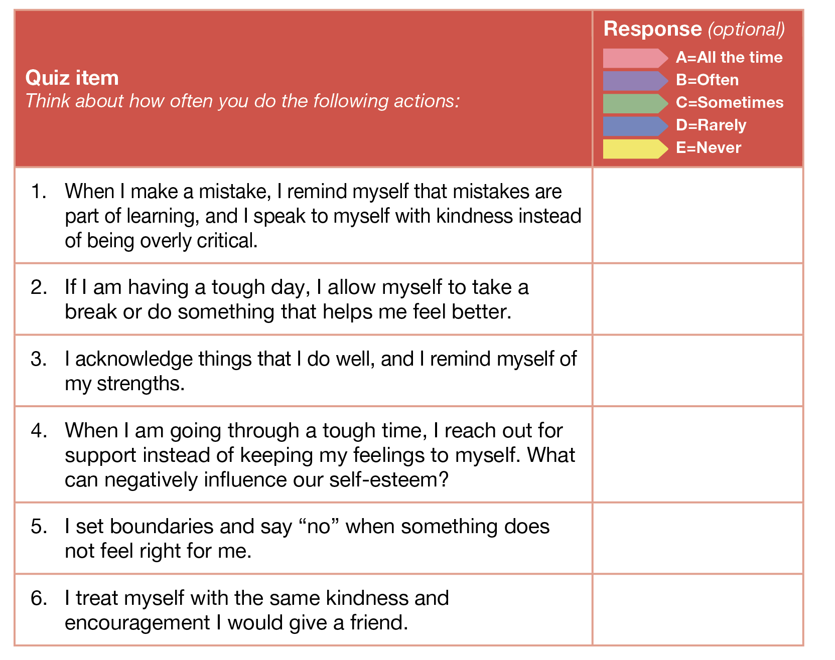
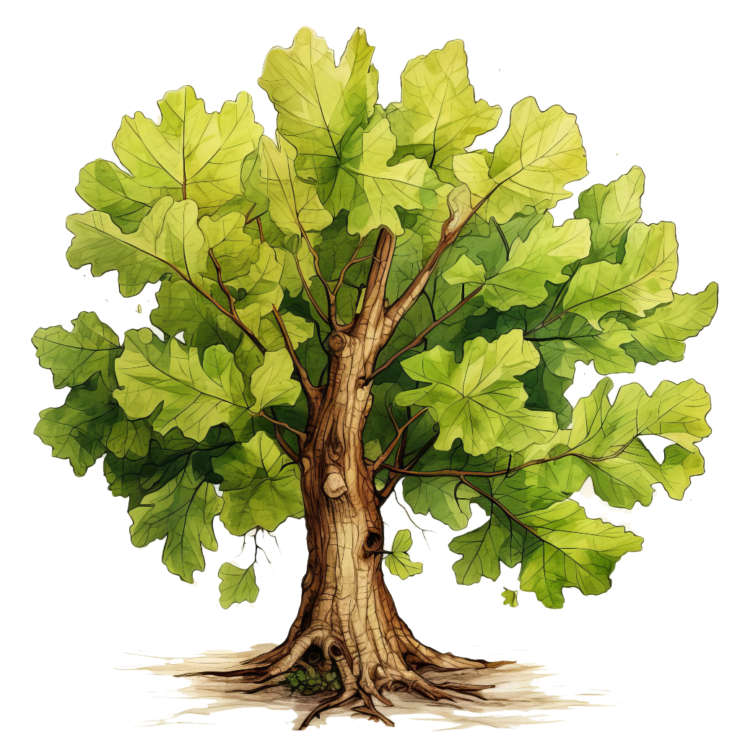
Emotional Wellbeing 3 | Activity 4, ‘Being kind to myself’

Slide 3
Connecting with my kind self through positive self-talk
Emotional Wellbeing 3 | Activity 4, ‘Being kind to myself’

Slide 4

Practising positive self-talk
Emotional Wellbeing 3 | Activity 4, ‘Being kind to myself’

Slide 5

Emotional Wellbeing 3 | Activity 4, ‘Being kind to myself’
Mindful Moment (Optional) – Celebrate Yourself Today, and Every Day: A Meditation to Honour Your Worth

