Slide 1
Understanding social connection for wellbeing
Activity 5, SPHE Emotional Wellbeing, Unit 3
Emotional Wellbeing 3 | Activity 5, 'Understanding social connection for wellbeing’

Slide 2
Think about your use of social media…
Emotional Wellbeing 3 | Activity 5, 'Understanding social connection for wellbeing’
How many people are you connected with on social media?
Or, think about the number of people you ‘know’ or recognise in school, your community, or activities.
Compare that with the number of people you actually talk to, spend time with, or share personal things with every day.

Slide 3
Write / Draw a few thoughts…
Emotional Wellbeing 3 | Activity 5, 'Understanding social connection for wellbeing’
What is most important for young people – the number of connections or the quality of connections, or both? Why?

Slide 4
Discuss
Emotional Wellbeing 3 | Activity 5, 'Understanding social connection for wellbeing’
• What makes a connection feel “quality” to you?
• How do we know when we have the right balance of quantity and quality in our social connections?

Slide 5
Types of support
Emotional Wellbeing 3 | Activity 5, 'Understanding social connection for wellbeing’
Support can show up in lots of different ways.
Sometimes it is about caring and comforting, for example listening when someone is upset or checking in on a friend to see how they are doing.
Other times it is about encouraging confidence, like reminding someone of their strengths or cheering them on.
Support can also be practical, such as helping out with tasks like carrying something heavy, sharing your notes, or giving a hand with homework.
Finally, it can mean sharing advice or tips, such as suggesting how to study for a test or explaining how you solved a problem.
Being supported strengthens our social connection with others and enhances our wellbeing.

Slide 6
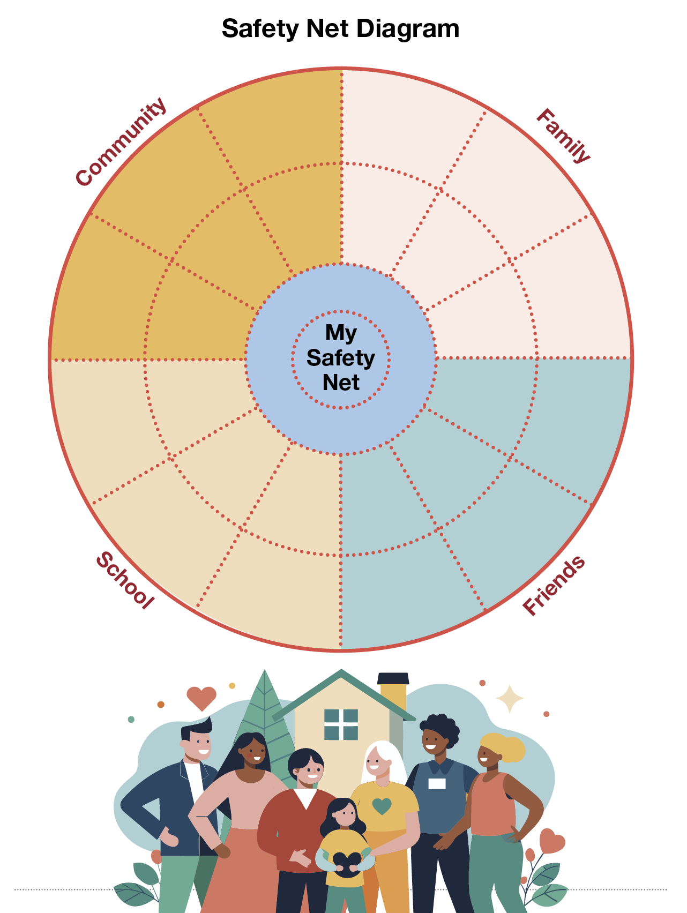
Emotional Wellbeing 3 | Activity 5, 'Understanding social connection for wellbeing’

Slide 7
Reflection
Emotional Wellbeing 3 | Activity 5, 'Understanding social connection for wellbeing’
What is one simple thing you will do today to strengthen your connection with someone in your family, with a friend, at school, or in the community?

