Slide 1
Understanding
Character Strengths
Activity 1, SPHE Emotional Wellbeing, Unit 3
Emotional Wellbeing 3 | Activity 1, ‘Understanding Character Strengths’

Slide 2

Emotional Wellbeing 3 | Activity 1, ‘Understanding Character Strengths’
Mindful Moment (Optional) – Beech Acres ‘Mindful Minute – Mindful Eyes’.

Slide 3
Journal prompt
Emotional Wellbeing 3 | Activity 1, ‘Understanding Character Strengths’
Describe/draw one thing you noticed today that you normally would not pay much attention to.
It could be: The sound of your favourite song playing, the colour of the sky or a tree you passed, objects in the classroom around you.
Who are you with, and what are you doing during these moments?

Slide 4
What is a ‘character strength’?
Emotional Wellbeing 3 | Activity 1, ‘Understanding Character Strengths’

Slide 5
Character strengths
Emotional Wellbeing 3 | Activity 1, ‘Understanding Character Strengths’
According to the Values in Action (VIA) Institute on Character, character strengths are positive traits reflected in thoughts, feelings, and behaviours that contribute to a person's overall wellbeing and moral character.
They are considered core aspects of a person's identity, and they can be developed over time.
Character strengths are different to talents, interests, and resources; they are positive traits that reflect who you are at your core at a given moment in time.

Slide 6
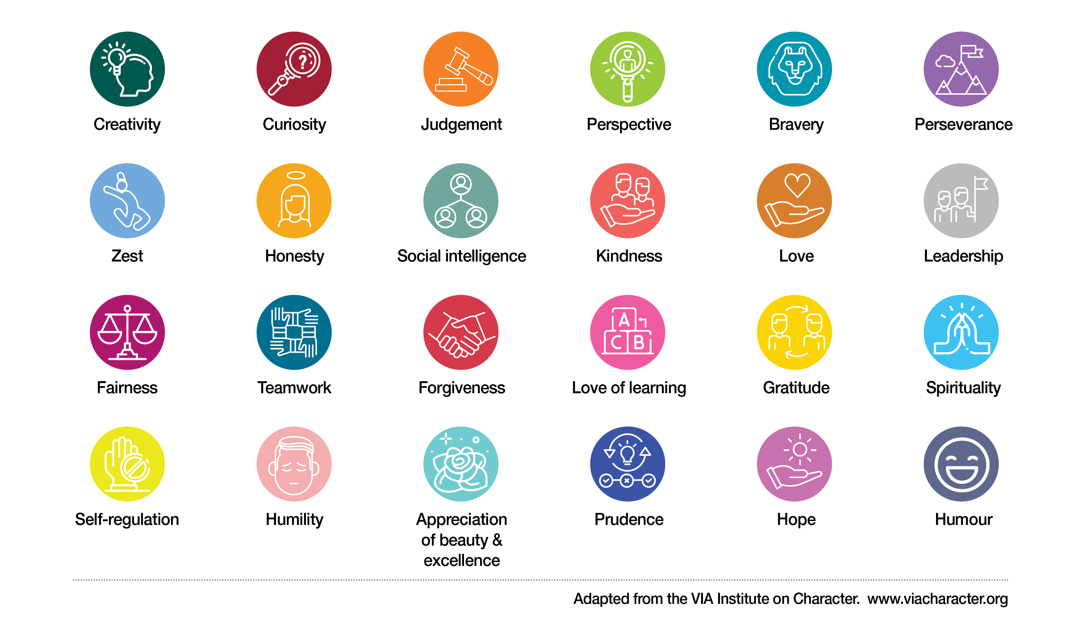
Revisiting character strengths
Emotional Wellbeing 3 | Activity 1, ‘Understanding Character Strengths’

Slide 7
Discuss
Emotional Wellbeing 3 | Activity 1, ‘Understanding Character Strengths’
Was it easy or difficult to identify different character strengths?
Is it useful (or not useful) to think about the character strengths we have?
Do you agree that character strengths can be developed?

Slide 8
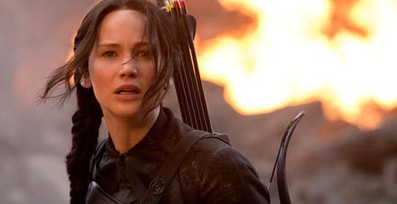
Emotional Wellbeing 3 | Activity 1, ‘Understanding Character Strengths’
Strength:
Character
‘Katniss Everdeen’
(From the film adaptation of Hunger Games,
by Suzanne Collins)
Example:
Strength:
Example:
Strength:
Example:

Slide 9
Emotional Wellbeing 3 | Activity 1, ‘Understanding Character Strengths’
Strength: Honesty
Character
‘Katniss Everdeen’
(From the film adaptation of Hunger Games,
by Suzanne Collins)
Example: Katniss tells the truth, even when it’s hard.
Strength: Kindness
Example: Katniss always takes good care of her sister.
Strength: Leadership
Example: Katniss encourages and motivates others to fight against President Snow.

Slide 10
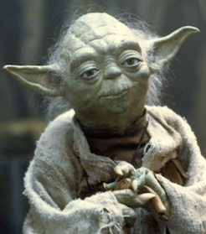
Emotional Wellbeing 3 | Activity 1, ‘Understanding Character Strengths’
Strength:
Character
‘Yoda’
(From the Star Wars film series, created by George Lucas)
Example:
Strength:
Example:
Strength:
Example:

Slide 11
Emotional Wellbeing 3 | Activity 1, ‘Understanding Character Strengths’
Strength: Wisdom/Judgement
Character
‘Yoda’
(From the Star Wars film series, created by George Lucas)
Example: Yoda gives thoughtful, philosophical advice to Jedis.
Strength: Perspective
Example: He helps others view situations calmly and with long-term vision.
Strength: Self-regulation
Example: He stays composed in moments of stress or temptation.

Slide 12

Emotional Wellbeing 3 | Activity 1, ‘Understanding Character Strengths’
Strength:
Character
‘Hermione Granger’
(From the Harry Potter series, authored by J.K. Rowling)
Example:
Strength:
Example:
Strength:
Example:

Slide 13
Emotional Wellbeing 3 | Activity 1, ‘Understanding Character Strengths’
Strength: Love of Learning
Character
‘Hermione Granger’
(From the Harry Potter series, authored by J.K. Rowling)
Example: Hermione is constantly reading and researching to help herself and others.
Strength: Perseverance
Example: She studies hard and doesn’t give up when she feels afraid
Strength: Fairness
Example: She fights for equality, including her campaign for house-elf rights.

Slide 14

Emotional Wellbeing 3 | Activity 1, ‘Understanding Character Strengths’
Strength:
Character
‘Harry Potter’
(From the Harry Potter series, authored by J.K. Rowling)
Example:
Strength:
Example:
Strength:
Example:

Slide 15
Emotional Wellbeing 3 | Activity 1, ‘Understanding Character Strengths’
Strength: Bravery
Character
‘Harry Potter’
(From the Harry Potter series, authored by J.K. Rowling)
Example: Harry faces Voldemort and other threats even though he feels afraid.
Strength: Love
Example: He stands by his friends and protects them.
Strength: Hope
Example: He holds onto hope that Voldemort can be defeated and that good will triumph, which helps him stay focused and courageous throughout his journey.

Slide 16
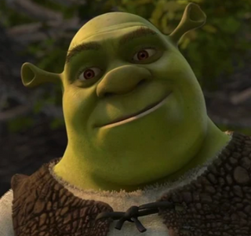
Emotional Wellbeing 3 | Activity 1, ‘Understanding Character Strengths’
Strength:
Example:
Character
‘Shrek’
(From Shrek, produced by DreamWorks Animation)
Strength:
Example:
Strength:
Example:

Slide 17
Emotional Wellbeing 3 | Activity 1, ‘Understanding Character Strengths’
Strength: Honesty
Example: Shrek stays true to who he is, even when others judge or misunderstand him. He does not pretend to be someone he is not to gain approval.
Character
‘Shrek’
(From Shrek, produced by DreamWorks Animation)
Strength: Love
Example: Despite his gruff attitude, Shrek shows deep care for others, especially Fiona and Donkey, and protects those he cares about.
Strength: Bravery
Example: He holds onto hope that Voldemort can be defeated and that good will triumph, which helps him stay focused and courageous throughout his journey.

Slide 18
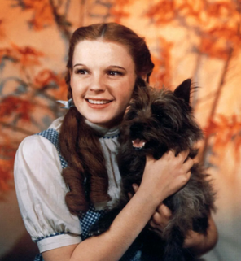
Emotional Wellbeing 3 | Activity 1, ‘Understanding Character Strengths’
Strength:
Character
‘Dorothy’
(From The Wizard of Oz, authored by L. Frank Baum)
Example:
Strength:
Example:
Strength:
Example:

Slide 19
Emotional Wellbeing 3 | Activity 1, ‘Understanding Character Strengths’
Strength: Hope
Character
‘Dorothy’
(From The Wizard of Oz, authored by L. Frank Baum)
Example: Dorothy keeps believing she will get home.
Strength: Gratitude
Example: She appreciates the help of her friends.
Strength: Curiosity
Example: She is eager to explore and understand the world of Oz.

Slide 20
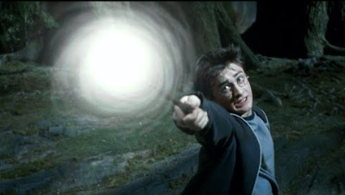
Reflecting on character strengths
Emotional Wellbeing 3 | Activity 1, ‘Understanding Character Strengths’
“Harry Potter” (from the film adaptation of the Harry Potter series, authored by J.K. Rowling). “Top 10 Most Searched For Harry Potter Scenes” (Harry Potter Official YouTube Channel)
(“Wizard’s Chess” scene, from Harry Potter and the Philosopher’s Stone: 07:19—9:37.
Duration: 2 minutes, 18 seconds).

Slide 21
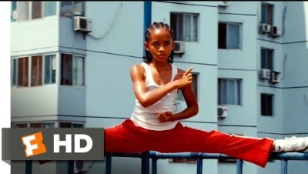
Reflecting on character strengths
Emotional Wellbeing 3 | Activity 1, ‘Understanding Character Strengths’
“Daniel LaRusso” (from The Karate Kid, directed by John G. Avildsen) “The Lessons Come Together” – The Karate Kid (Movieclips YouTube Channel)
(“The Lessons Come Together” scene, from The Karate Kid. Duration: 2 minutes, 30 seconds).

Slide 22

Hero’s Medal
Emotional Wellbeing 3 | Activity 1, ‘Understanding Character Strengths’
A person I admire is [name]: ________________________________________________
They use [insert strength 1] ______________________ to: ___________________________________________________________________________________________________________________________________________________________________________________________________________________________________________________
They use [insert strength 2] ______________________ to: ___________________________________________________________________________________________________________________________________________________________________________________________________________________________________________________
They use [insert strength 3] ______________________ to: ___________________________________________________________________________________________________________________________________________________________________________________________________________________________________________________

