Slide 1
Identifying my strengths
Activity 2, SPHE Emotional Wellbeing, Unit 3
Emotional Wellbeing 3 | Activity 2, ‘Identifying my strengths’

Slide 2

Emotional Wellbeing 3 | Activity 2, ‘Identifying my strengths’
Mindful Moment (Optional) – 2-Minute Quick Focus Reset Meditation (Headspace)

Slide 3
Journal prompt
Emotional Wellbeing 3 | Activity 2, ‘Identifying my strengths’
What is one thing I am grateful for today?
What is one thing I want to focus on today?

Slide 4
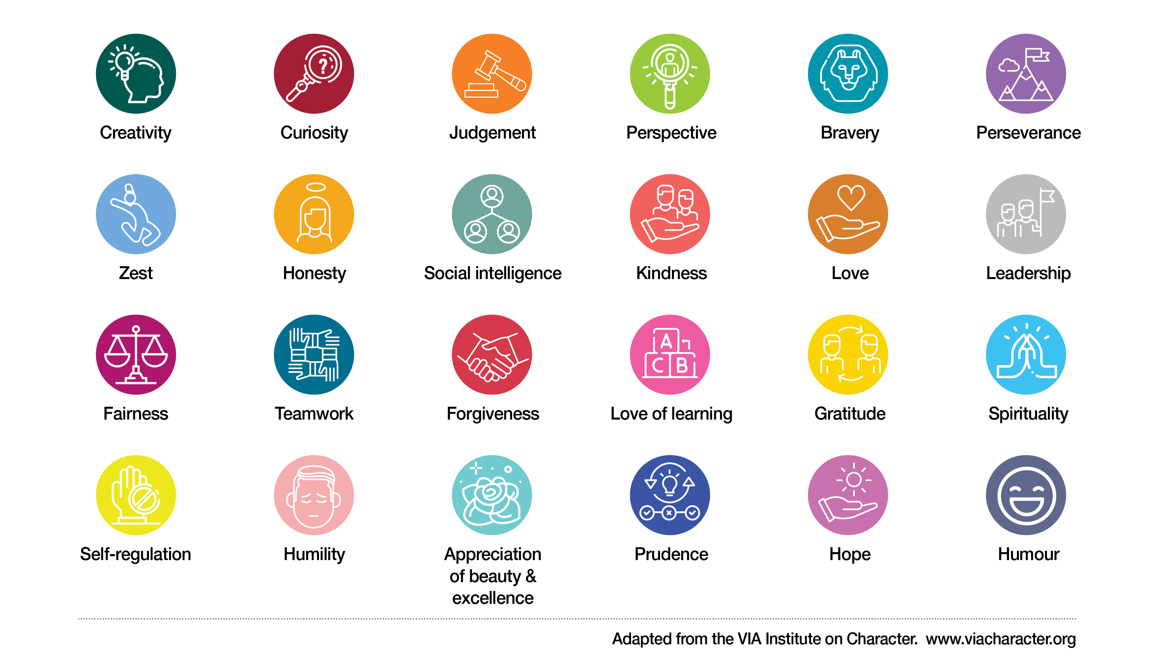
Spotting character strengths
Emotional Wellbeing 3 | Activity 1, ‘Understanding Character Strengths’

Slide 5
Dice Game
Emotional Wellbeing 3 | Activity 2, ‘Identifying my strengths’
What do you think are your top three character strengths?
What is one character strength that you enjoy using? Why do you like using it?
Which character strengths seem to come naturally to you? Explain why.
Give an example of a time you have used a character strength.
What character strength could help you to reach a goal or goals? Explain why.
Ask others in the group to suggest a character strength they see in you.

Slide 6
Class Strengths Word Cloud
Emotional Wellbeing 3 | Activity 2, ‘Identifying my strengths’

Slide 7
Discuss
Emotional Wellbeing 3 | Activity 2, ‘Identifying my strengths’
What class strengths emerge from the word cloud?

Slide 8
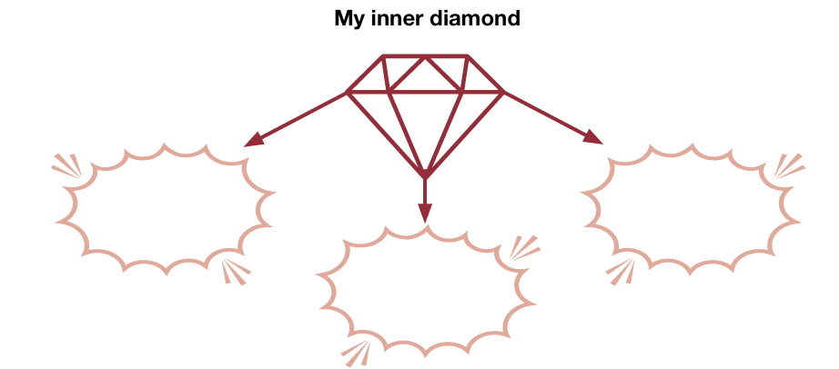
Reflecting on my strengths
Emotional Wellbeing 3 | Activity 2, ‘Identifying my strengths’

Slide 9
Inner diamond strengths reflection prompts
Emotional Wellbeing 3 | Activity 2, ‘Identifying my strengths’
What 3 character strengths did you identify? (The three strengths you use the most).
How do your strengths enable you to manage better at school/in your life?
Are there any situations where your strengths might hold you back, present challenges, or may not serve you well?

