Slide 1
Understanding my world and me
Activity 7, SPHE Emotional Wellbeing, Unit 3
Emotional Wellbeing 3 | Activity 7, ‘Understanding my world and me’

Slide 2
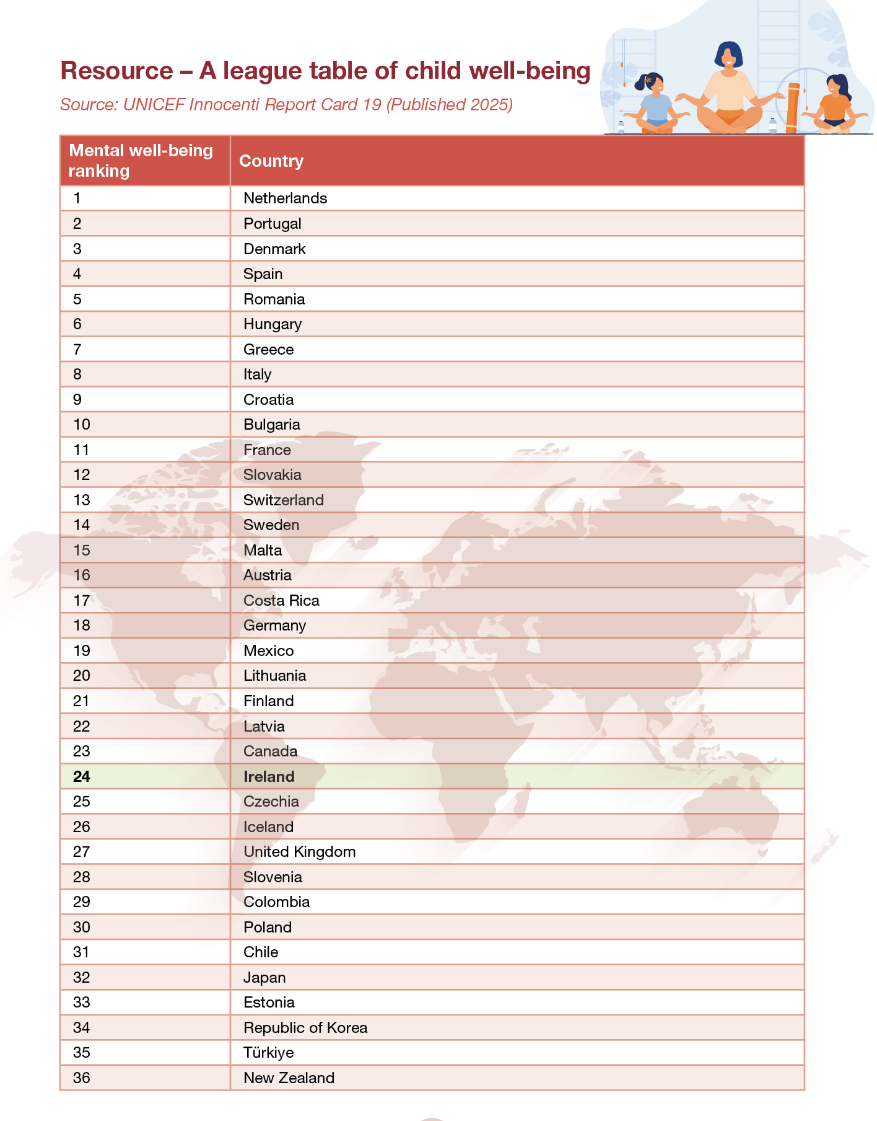
Emotional Wellbeing 3 | Activity 7, ‘Understanding my world and me’

Slide 3
League table Q’s
Emotional Wellbeing 3 | Activity 7, ‘Understanding my world and me’
Looking at the countries that ranked highest and lowest for wellbeing, can you offer any suggestions as to why this might be?
Do any surprise you? Why/why not?
Why do you think there are differences in wellbeing in different countries?

Slide 4
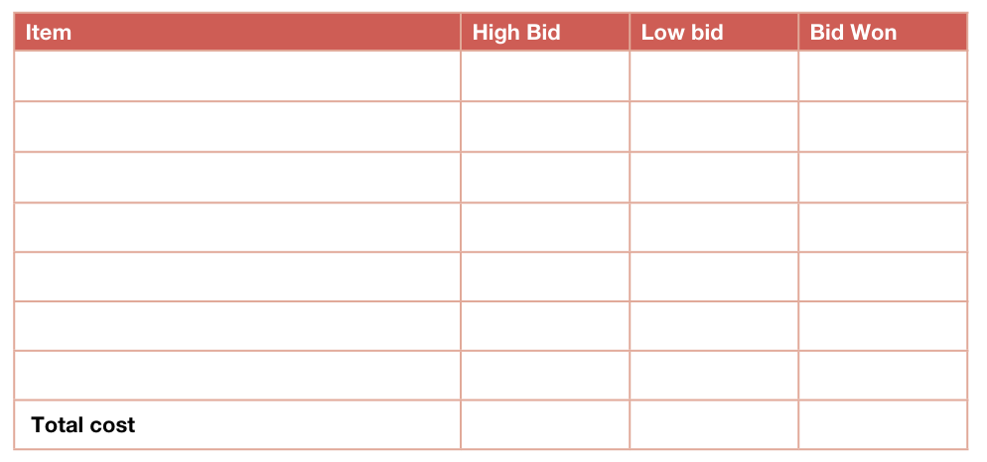
The Wellbeing Auction
Emotional Wellbeing 3 | Activity 7, ‘Understanding my world and me’

Slide 5
How can Ireland do better to support young people's wellbeing?
Emotional Wellbeing 3 | Activity 7, ‘Understanding my world and me’

Slide 6
Reflecting on my world and me
Emotional Wellbeing 3 | Activity 7, ‘Understanding my world and me’
• One thing I learned about wellbeing is…
• Something that surprised me was…
• I now understand that wellbeing is shaped by...

