Slide 1
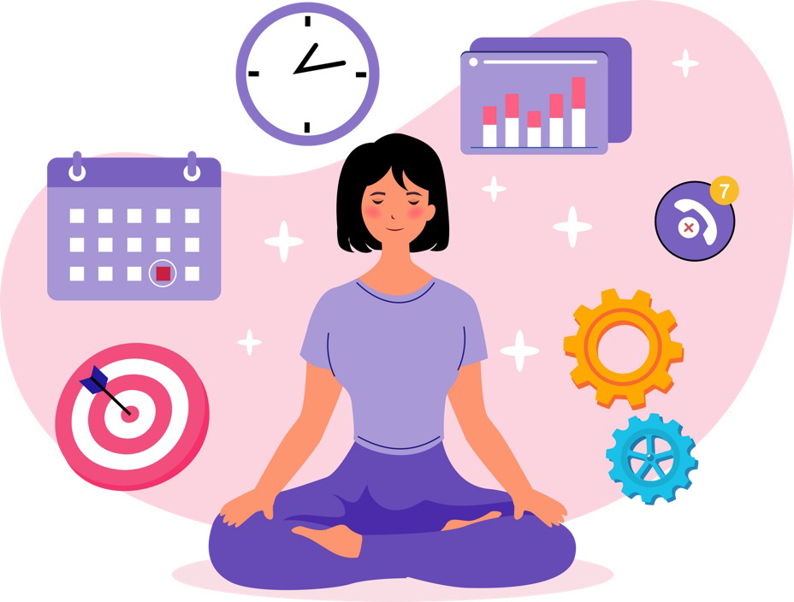
Managing Stress
Activity 7, SPHE Emotional Wellbeing, Unit 2
Emotional Wellbeing 2 | Activity 7, ‘Managing Stress’

Slide 2
Option 1 - Square Breathing
Emotional Wellbeing 2 | Activity 7, ‘Managing Stress’
2. Hold for 4 seconds...
Count for four seconds as you inhale a breath
Hold this breath for four seconds
Count for four seconds as you breath out
1. Slowly inhale for 4 seconds...
3. Slowly inhale for 4 seconds...
Hold your breath for four seconds before inhaling again
3. Hold for 4 seconds...
Students can complete a journalling exercise if they prefer. “If there is anything stuck on your mind, use this space to let it go” (SPHE Copy).

Slide 3
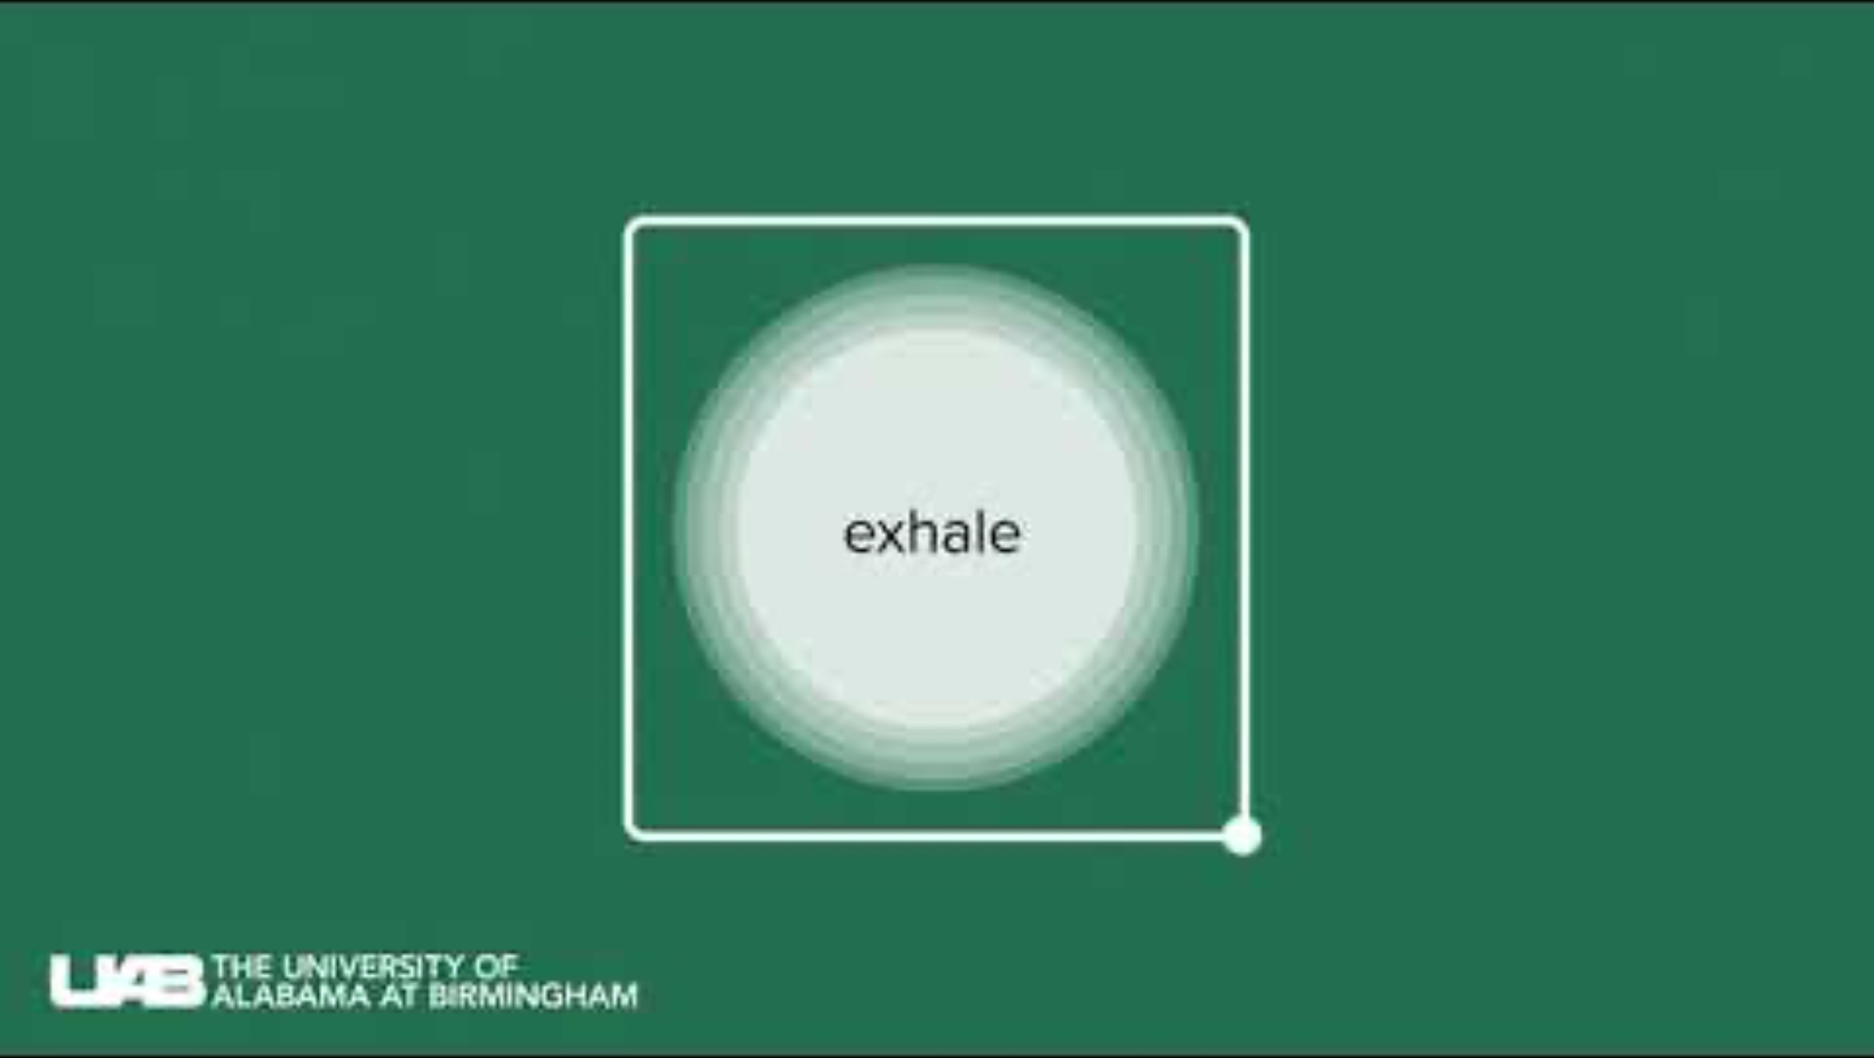
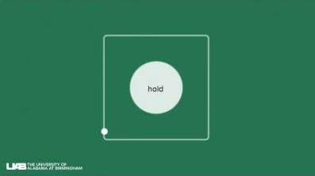
Square Breathing (No Voiceover)
Emotional Wellbeing 2 | Activity 7, ‘Managing Stress’
Students can complete a journalling exercise if they prefer. “If there is anything stuck on your mind, use this space to let it go” (SPHE Copy).

Slide 4
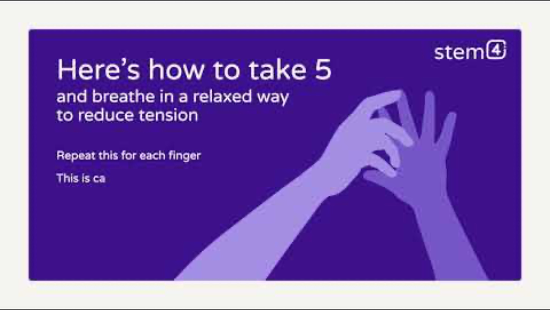

Take-5 Breathing
Emotional Wellbeing 2 | Activity 7, ‘Managing Stress’
Students can complete a journalling exercise if they prefer. “If there is anything stuck on your mind, use this space to let it go” (SPHE Copy).

Slide 5

Option 2 -
Emotional Wellbeing 2 | Activity 7, ‘Managing Stress’
“If there’s anything stuck on your mind today, use this space to let it go.”
Let it go
Write, Draw or Doodle in your SPHE copy or on the worksheet for a few minutes.

Slide 6
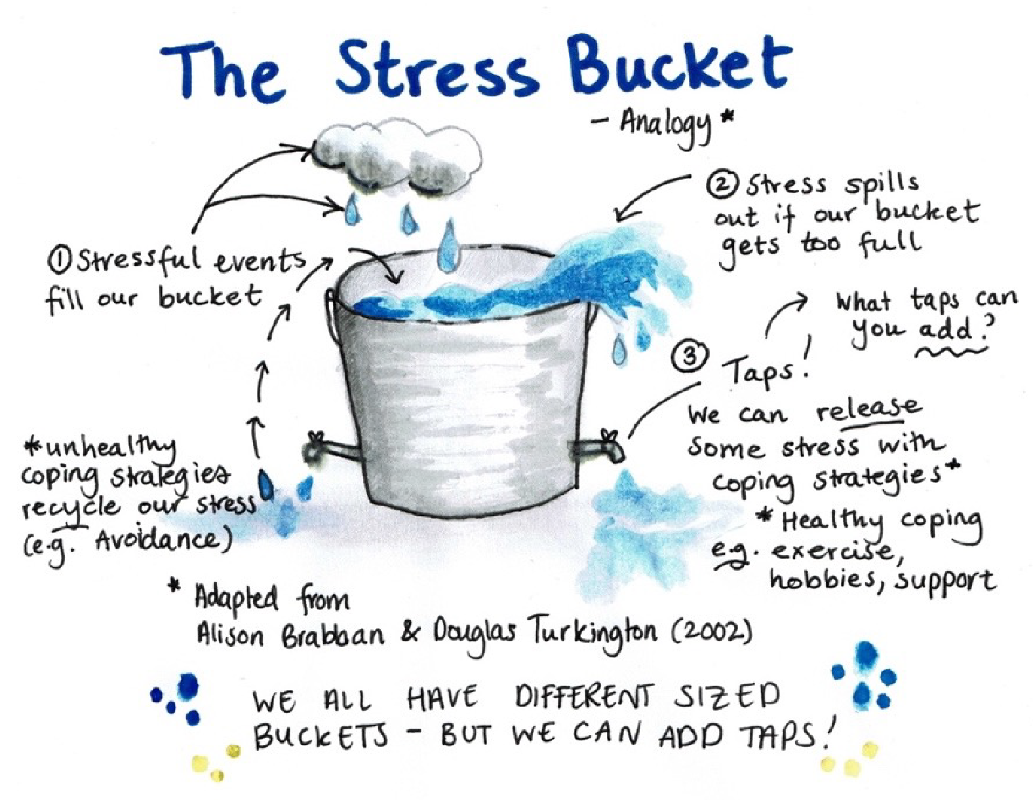
Step 2: Understanding coping strategies
Emotional Wellbeing 2 | Activity 7, ‘Managing Stress’

Slide 7
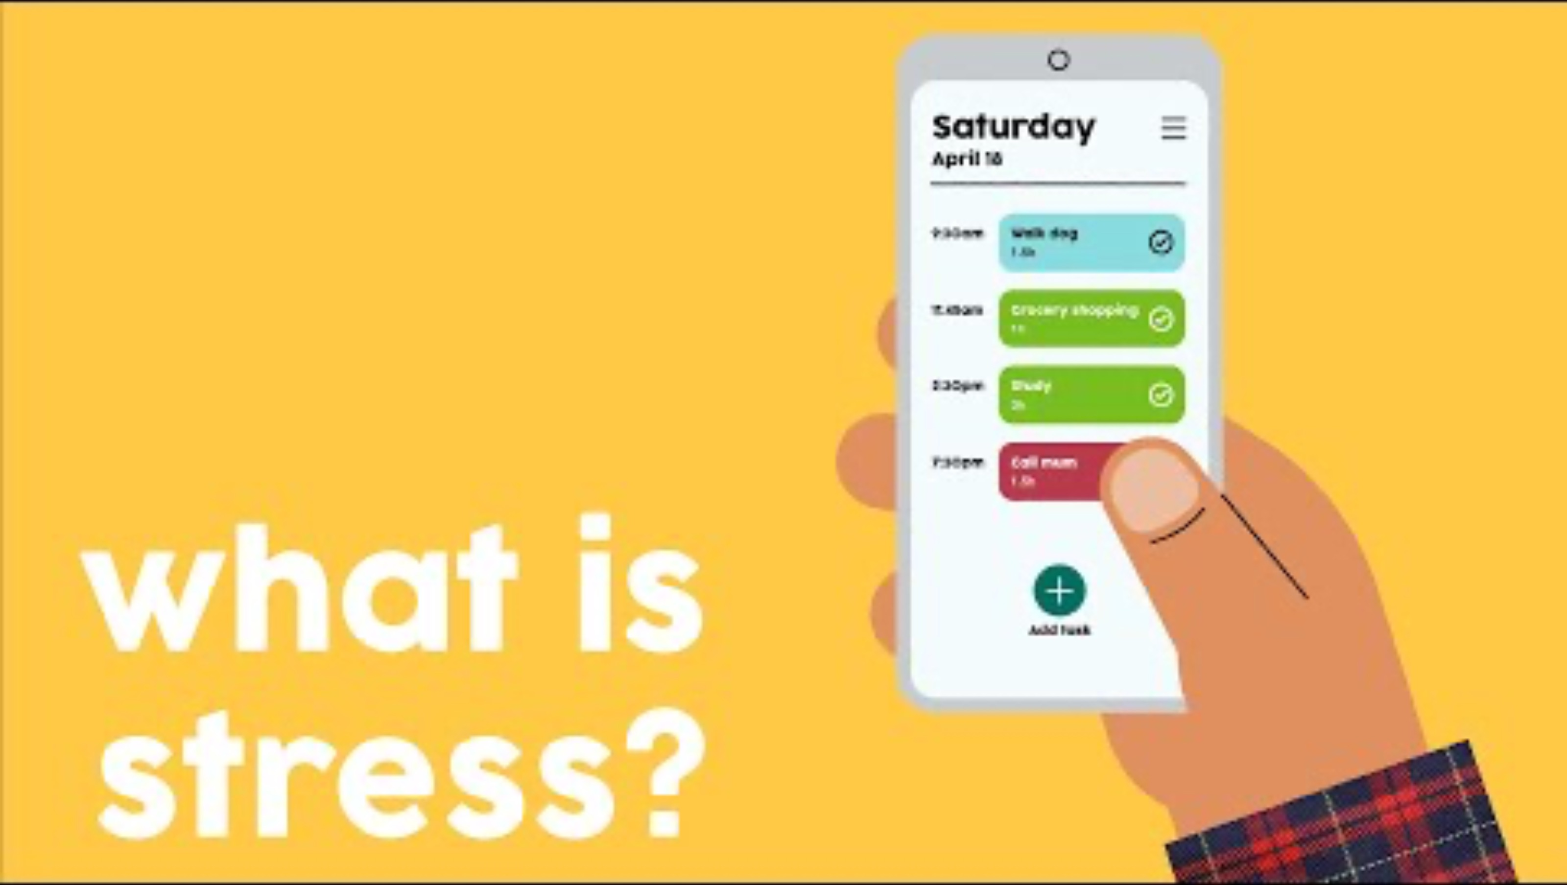
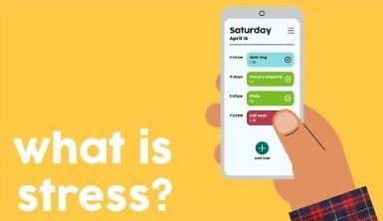
Emotional Wellbeing 2 | Activity 7, ‘Managing Stress’
Headspace by Stride, ‘What is Stress?’

Slide 8

What taps do you use to reduce your stress?
Emotional Wellbeing 2 | Activity 7, ‘Managing Stress’

Slide 9



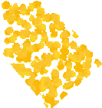
Healthy Coping Checklist
Emotional Wellbeing 2 | Activity 7, ‘Managing Stress’
What are some of the Healthy Coping Strategies that you have used in the last month? Check these off on the checklist.
What are some of the Healthy Coping Strategies that you could use? Circle these or make a list in your Wellbeing Journal.

Slide 10
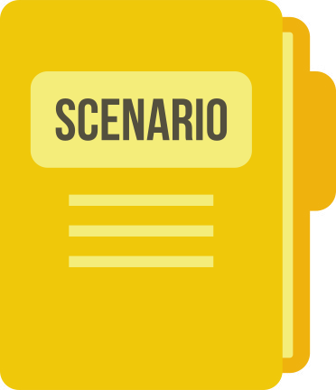
Scenarios,
Example
Emotional Wellbeing 2 | Activity 7, ‘Managing Stress’
Ethan is anxious about an upcoming class presentation. He’s worried about speaking in front of his classmates and fears making mistakes or being judged.

Slide 11

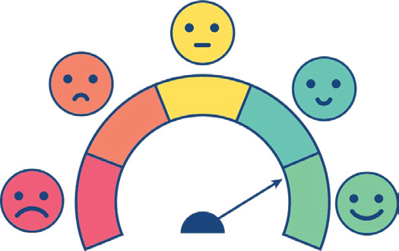


Emotional Wellbeing 2 | Activity 7, ‘Managing Stress’
SEEK SOCIAL SUPPORT | MANAGE EMOTIONS
REFRAME THOUGHTS | DO SOMETHING PRACTICAL

Slide 12

Social Support
Emotional Wellbeing 2 | Activity 7, ‘Managing Stress’
Ethan could…
Ask a classmate/friend/family member to practice with him.

Slide 13
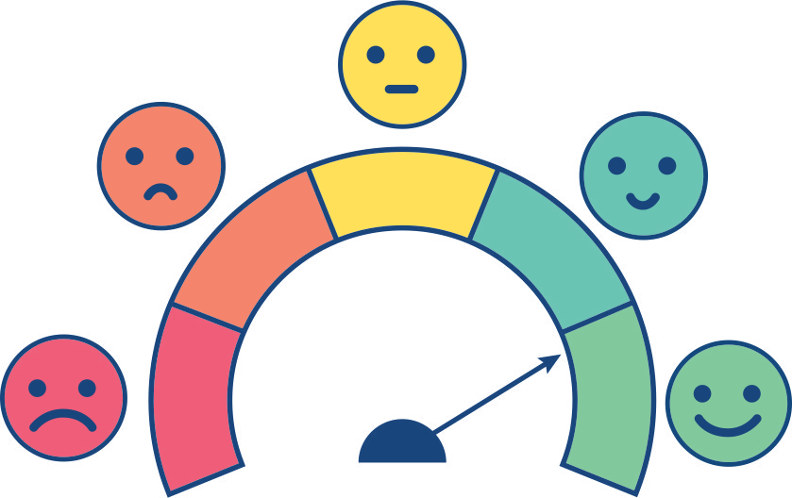
Managing Emotions
Emotional Wellbeing 2 | Activity 7, ‘Managing Stress’
Ethan could…
Practice relaxation techniques like deep breathing or visualisation to calm his nerves to help ground himself.

Slide 14

Reframe Thoughts
Emotional Wellbeing 2 | Activity 7, ‘Managing Stress’
Ethan could…
Say/Think something nice and encouraging (practice positive self- talk), replacing unhelpful thoughts about the presentation with more realistic and constructive ones. For example, instead of thinking “I’ll definitely mess up,” he could say to himself, “I am prepared, and I’m ready to do my best.”
I can do this

Slide 15


Reframe Thoughts
Emotional Wellbeing 2 | Activity 7, ‘Managing Stress’
I am ready to try my best
I am prepared/ I can do this
I am excited

Slide 16

Do Something Practical
Emotional Wellbeing 2 | Activity 7, ‘Managing Stress’
Ethan could…
Ethan could create flashcards with key points from his presentation to refer to if he forgets what to say.

Slide 17
Your Turn!
Emotional Wellbeing 2 | Activity 7, ‘Managing Stress’

Slide 18
Scenarios
Emotional Wellbeing 2 | Activity 7, ‘Managing Stress’
John feels stressed out because he’s caught in the middle of an argument between two friends. He worries about losing his friends or making the situation worse by taking sides.
Elena has an important assessment due in two weeks, but she finds herself constantly delaying starting on it. She spends hours scrolling through TikTok and chatting with friends. She begins to panic about not having enough time to prepare.
Ró feels anxious in social situations. Ró is meeting a new friend after school, and she is worried about saying or doing something embarrassing.
Ahmed has a big test coming up, and he’s feeling anxious about it. He’s worried about forgetting what he’s studied or not doing well, even though he’s prepared.
Maya has a big sports game coming up, and she’s feeling anxious about performing well. She worries about letting her team down and not meeting expectations.

Slide 19
A. What could the person in the scenario do to cope with the situation to seek social support?
Emotional Wellbeing 2 | Activity 7, ‘Managing Stress’
B. What could the person in the scenario do to cope with the situation to manage their emotions?
C. What could the person in the scenario do to cope with the situation to reframe their thoughts?
D. What is something practical the person in the scenario could do?

Slide 20
Practice Being Present
Emotional Wellbeing 2 | Activity 7, ‘Managing Stress’
Look around your space you are in for a moment.
What colours are around you?
What is one thing that you find interesting about the space around you?
What is one small thing that you can do right at this moment to make you feel 1% better?
Taking a drink of water, stretching, standing, moving around?
Students can complete a journalling exercise if they prefer. “If there is anything stuck on your mind, use this space to let it go” (SPHE Copy).

