Slide 1
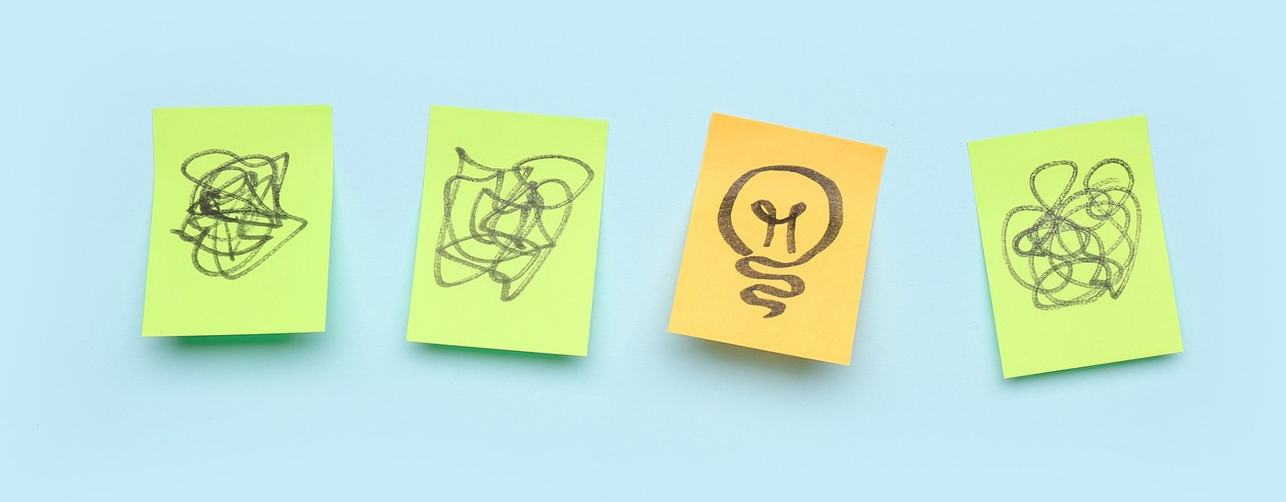
Understanding Thoughts
Activity 4, SPHE Emotional Wellbeing, Unit 2
Emotional Wellbeing 2 | Activity 4, ‘Understanding Thoughts’

Slide 2

Emotional Wellbeing 2 | Activity 4, ‘Understanding Thoughts’
St Patrick’s Mental Health Service

Slide 3
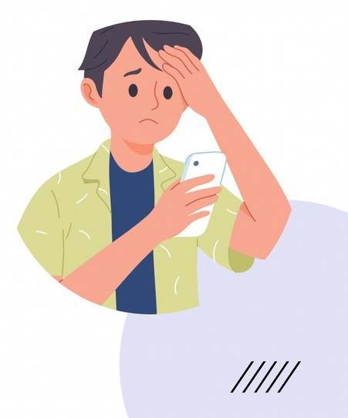
Have you ever sent a message on what’s app or social media and the recipient hasn’t opened or took a long time to respond?
Emotional Wellbeing 2 | Activity 4, ‘Understanding Thoughts’
What were you thinking?
How did you feel and behave?

Slide 4

Step 2: Identifing thinking traps
Emotional Wellbeing 2 | Activity 4, ‘Understanding Thoughts’
Thinking traps are unhelpful, automatic thought patterns that, when left unchecked, can lead to unpleasant feelings.
They can make us believe things that aren’t necessarily true.
Lets have a look at some Thinking Traps

Slide 5
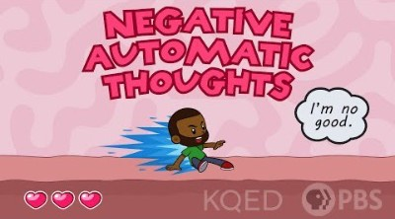
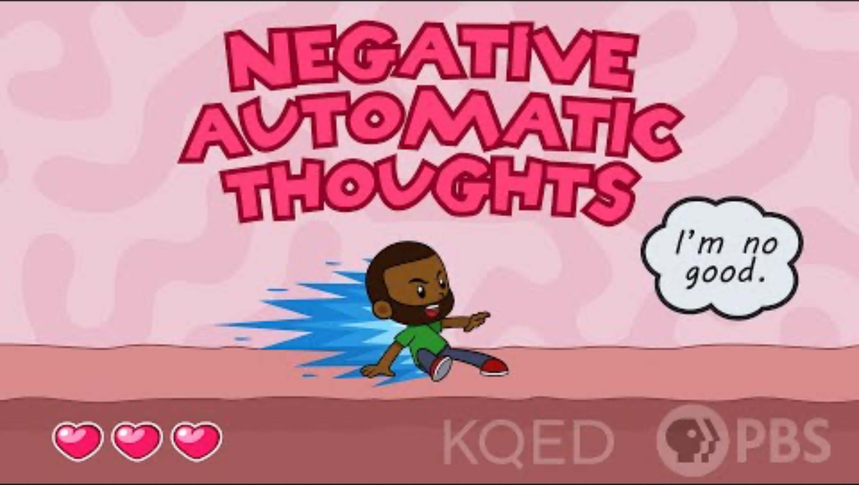
Thinking Traps
Emotional Wellbeing 2 | Activity 4, ‘Understanding Thoughts’
Complete the ‘What are Thinking Traps’ handout while you are watching the video.

Slide 6


Emotional Wellbeing 2 | Activity 4, ‘Understanding Thoughts’
TRAP #1
ALL-OR-NOTHING THINKING
When you make big generalisations
(Keywords: All, Always,
Never, None, Everyone, Nobody, etc.)

Slide 7

TRAP #2 ‘NEGATIVE LABELLING’
Emotional Wellbeing 2 | Activity 4, ‘Understanding Thoughts’
When you use negative labels for yourself. (Keywords: “I’m a…” followed by a negative word).

Slide 8
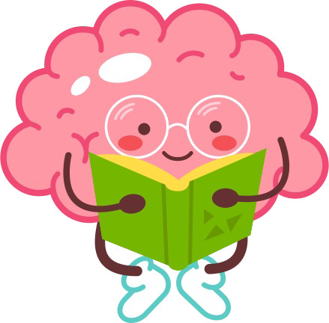
Emotional Wellbeing 2 | Activity 4, ‘Understanding Thoughts’
TRAP #3
MIND READING
When you assume you know what someone else is thinking or feeling.

Slide 9

TRAP #4 NEGATIVE FILTER
Emotional Wellbeing 2 | Activity 4, ‘Understanding Thoughts’
When you focus only on the negatives.

Slide 10
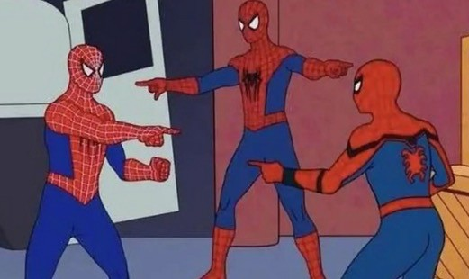
TRAP #5 CATASTROPHISING
Emotional Wellbeing 2 | Activity 4, ‘Understanding Thoughts’
Blowing things out of proportion; dwelling on the worst possible outcomes.

Slide 11

Emotional Wellbeing 2 | Activity 4, ‘Understanding Thoughts’
TRAP #6 ‘SHOULDS’
When you think about what you “should” (or shouldn’t) do or be like.

Slide 12

TRAP #7
FORTUNE TELLING
Emotional Wellbeing 2 | Activity 4, ‘Understanding Thoughts’
When you predict or assume something ‘bad’ will happen without any real evidence.

Slide 13

Step 2: Gratitude Exercise
Emotional Wellbeing 2 | Activity 4, ‘Understanding Thoughts’
List three things that you are grateful for.
Try to be as specific and detailed as possible.
Example: I am grateful...
For the teacher who said hello to me today and made school a better place to be.
For my best friend who made me laugh this morning.
For my breakfast that nourishes me and because I share that time with my family.

Slide 14

Gratitude Exercise
Emotional Wellbeing 2 | Activity 4, ‘Understanding Thoughts’
Our thoughts influence our feelings and actions.
Gratitude is recognising and appreciating the good things in our lives.
Practicing gratitude, can help promote balanced thinking as we learn to focus on the positive which improves our mood and overall wellbeing. It does not take our worries away but allows us space to consider the bigger picture.

