Slide 1
Minding myself in challenging times
Activity 1, SPHE Emotional Wellbeing, Unit 3
Emotional Wellbeing 3 | Activity 8, ‘Minding myself in challenging times’

Slide 2
Think about…
Emotional Wellbeing 3 | Activity 8, ‘Minding myself in challenging times’
What are some examples of common challenges experienced by people your age?

Slide 3
Discuss
Emotional Wellbeing 3 | Activity 8, ‘Minding myself in challenging times’
How can we recognise when a challenge is starting to affect our wellbeing?

Slide 4
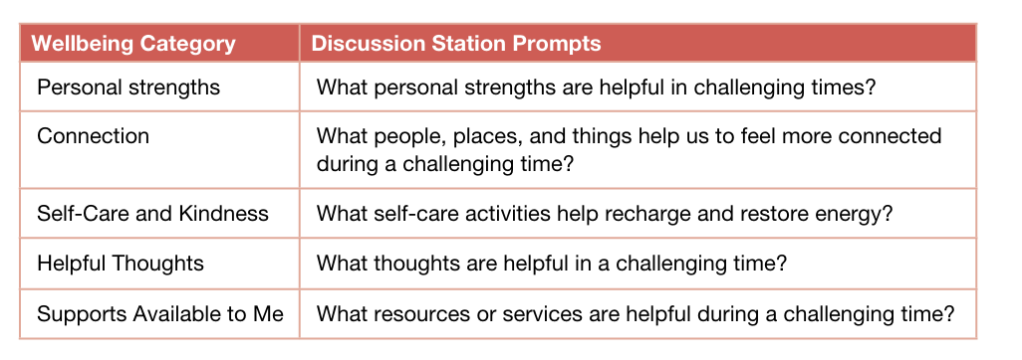
Exploring strategies for action during challenging times
Emotional Wellbeing 3 | Activity 8, ‘Minding myself in challenging times’

Slide 5
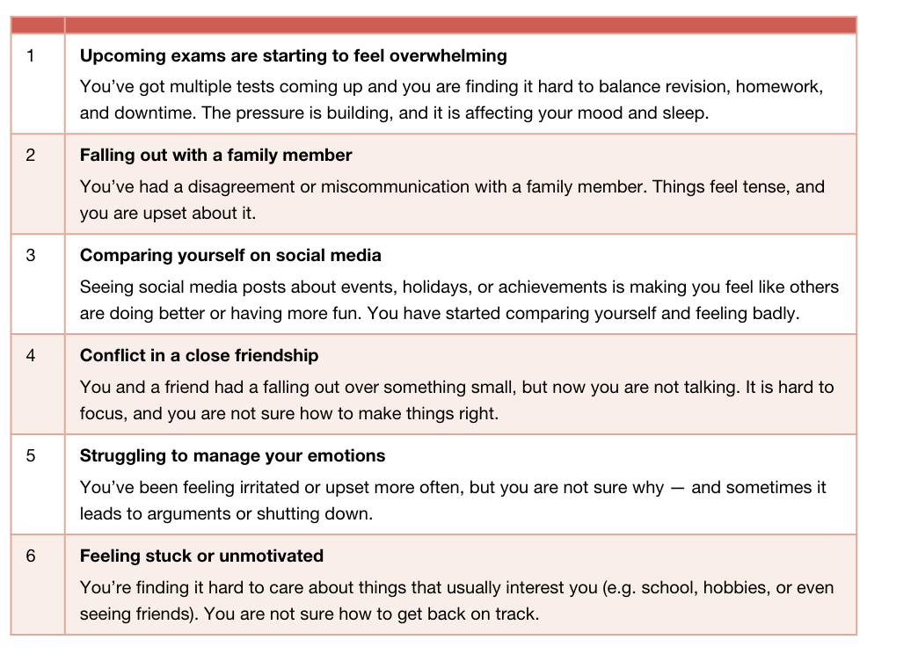
Challenge scenarios
Emotional Wellbeing 3 | Activity 8, ‘Minding myself in challenging times’

Slide 6
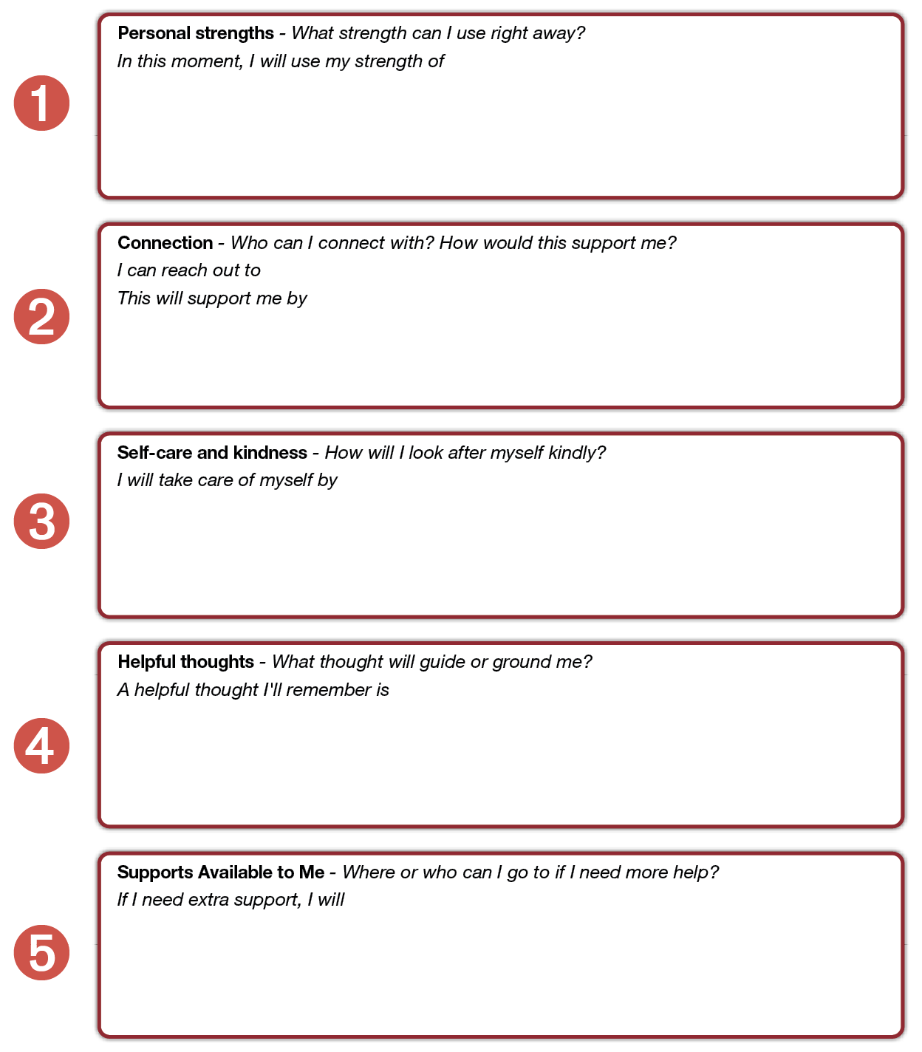
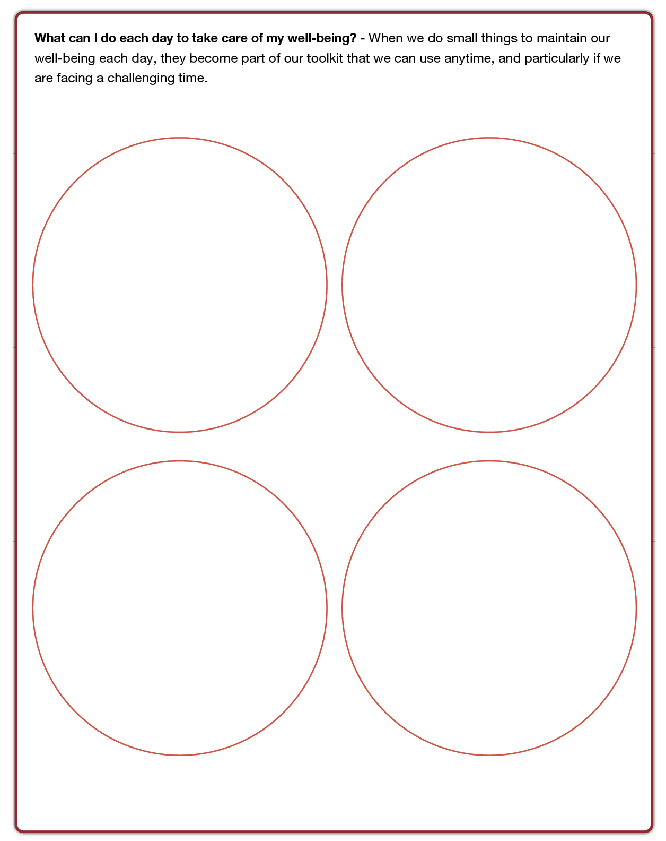
Creating my action plan for challenging times
Emotional Wellbeing 3 | Activity 8, ‘Minding myself in challenging times’

Slide 7

Emotional Wellbeing 3 | Activity 8, ‘Minding myself in challenging times’
Mindful Moment (Optional) – Headspace, ‘Unwind’

Slide 8
Reflection
Emotional Wellbeing 3 | Activity 8, ‘Minding myself in challenging times’
Take a moment to think about:
1. One thing you can see
2. One thing you can hear
3. One thing you’re looking forward to
(today or this week)

