Slide 1

Managing Thoughts
Activity 5, SPHE Emotional Wellbeing, Unit 2
Emotional Wellbeing 2 | Activity 4, ‘Managing Thoughts’

Slide 2
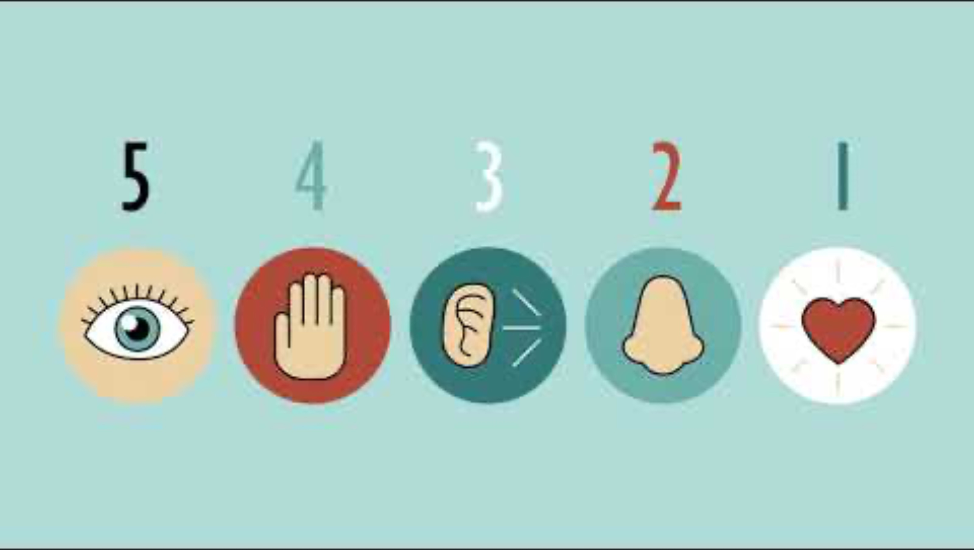
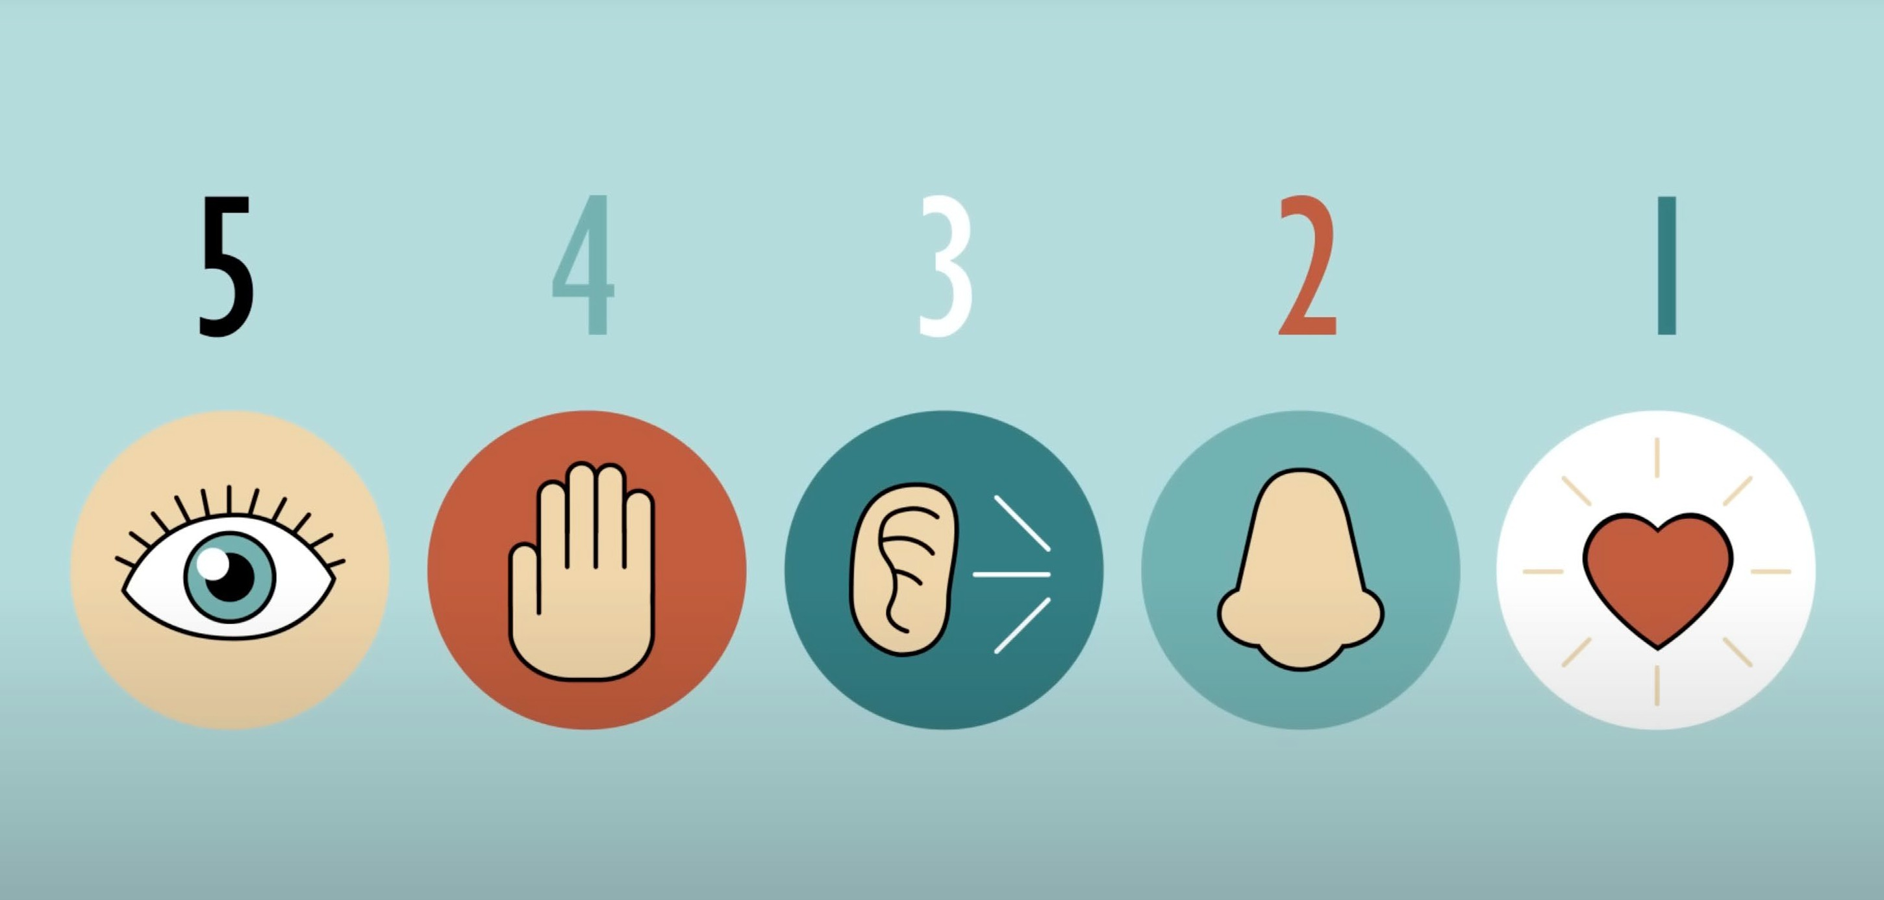
Step 1: Focusing exercise
Emotional Wellbeing 2 | Activity 4, ‘Managing Thoughts’
The Partnership in Education, 5-4-3-2-1 Focusing Exercise.

Slide 3


If there is anything stuck on your mind, you can use this space to let it go
Emotional Wellbeing 2 | Activity 4, ‘Managing Thoughts’
Or, simply take a moment to reflect if you wish

Slide 4

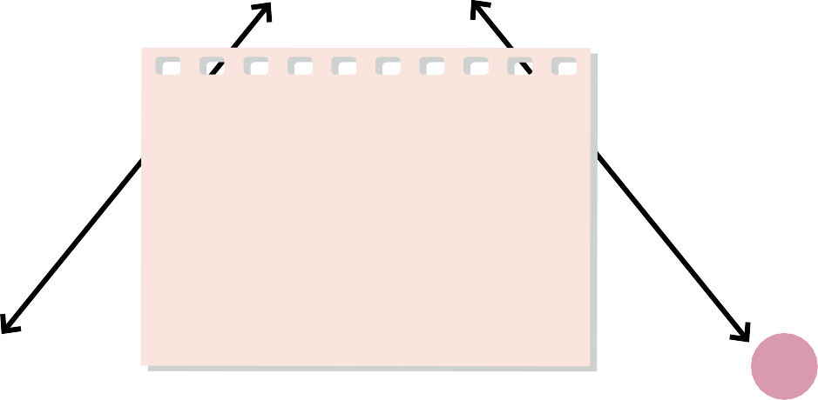


Step 1: The Cognitive Triangle
Emotional Wellbeing 2 | Activity 4, ‘Managing Thoughts’
1
The event/situation what happened? My team wins a big rugby final and I score the winning try
2
What did you do?
Jumped in the air / Screamed Hugged my teammates / Cried
3
4
What were you thinking?
I can't believe I just did that
What were you feeling?
Happy / Proud / Excited / Confident / Elated
I'm a legend / This is amazing

Slide 5

Step 3: Reframing Thoughts
Emotional Wellbeing 2 | Activity 4, ‘Managing Thoughts’
Catch It
Check It Change It

Slide 6

Catch it – first we need to recognise that we are in a thinking trap.
Emotional Wellbeing 2 | Activity 4, ‘Managing Thoughts’
Using your emotions and behaviours as cues - stop when you might be having negative thoughts.
Ask yourself, “What am I thinking?”

Slide 7

Emotional Wellbeing 2 | Activity 4, ‘Managing Thoughts’
Check it this involves using thought challengers that examine the thought. Remember it can
be hard to take a step back so sometimes talking it through with someone can help.

Slide 8
Useful Thought Challengers are:
Emotional Wellbeing 2 | Activity 4, ‘Managing Thoughts’
Am I assuming the worst?
Is there evidence that this thought is true?
Is the situation in or out of my control?
What would I say to my best friend if they had this thought?
Is this thought helpful?

Slide 9

Change it – reframe the thought so it is more balanced. Remember this takes practice.
Emotional Wellbeing 2 | Activity 4, ‘Managing Thoughts’

Slide 10
Example of Reframing
Emotional Wellbeing 2 | Activity 4, ‘Managing Thoughts’
Situation: You fail a test.
Negative Thought: “I’m a failure. I’ll never be good at this.”
Question the Thought: Is it true that you’re a failure just because you failed one test? Did you study enough? Can you improve next time?
Reframed Thought: “I didn’t do well this time, but I can study harder and do better on the next test.”

Slide 11


Step 4: Having a Mantra
Emotional Wellbeing 2 | Activity 4, ‘Managing Thoughts’
I am good enough
I am strong
I am powerful
I am lovable
I deserve good things
I believe in myself and my abilities

