Slide 1
Navigating challenges in healthy relationships
Activity 6, SPHE Emotional Wellbeing, Unit 3
Emotional Wellbeing 3 | Activity 6, ‘Navigating challenges in healthy relationships’

Slide 2
Discuss
Emotional Wellbeing 3 | Activity 6, ‘Navigating challenges in healthy relationships’
• In what ways can a good, healthy relationship still include moments of challenge, frustration or hurt?

Slide 3
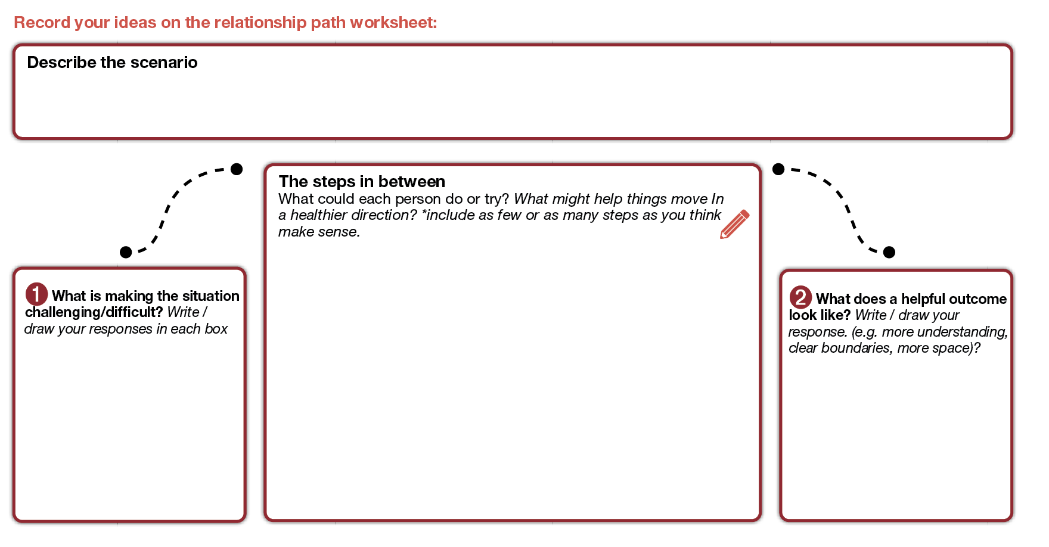
Emotional Wellbeing 3 | Activity 6, ‘Navigating challenges in healthy relationships’
The relationship path

Slide 4
Reflection
Emotional Wellbeing 3 | Activity 6, ‘Navigating challenges in healthy relationships’
• What am I taking away from today, and what does this mean for me?

