Slide 1
Appreciating myself
Activity 3, SPHE Emotional Wellbeing, Unit 3
Emotional Wellbeing 3 | Activity 3, ‘Appreciating myself’

Slide 2

Emotional Wellbeing 3 | Activity 3, ‘Appreciating myself’
Mindful Moment (Optional) – Mindfulness through the sunrise: Using sunrise photography to appreciate nature

Slide 3
Journal prompt
Emotional Wellbeing 3 | Activity 3, ‘Appreciating myself’
Think back on today (or this week). What was one small moment that felt beautiful, peaceful, or meaningful, even if no one else noticed it?

Slide 4
Emotional Wellbeing 3 | Activity 3, ‘Appreciating myself’

Slide 5
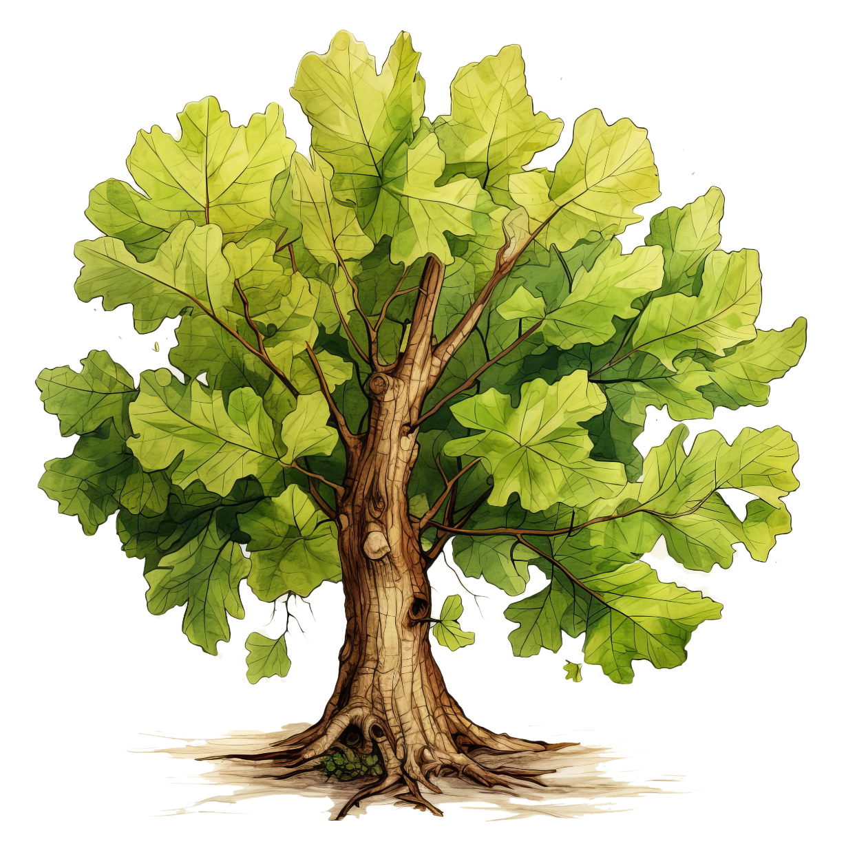
What shapes self-esteem?
Emotional Wellbeing 3 | Activity 3, ‘Appreciating myself’
What influences our self-esteem?
What can positively influence our self-esteem?
What can negatively influence our self-esteem?

Slide 6
Notes of Appreciation
Emotional Wellbeing 3 | Activity 3, ‘Appreciating myself’
• One thing I really admire about you is...
• Something you do well that I have noticed is…
• You are great at…
• I appreciate you because…
• Thank you for...

Slide 7
Notes of Appreciation
Emotional Wellbeing 3 | Activity 3, ‘Appreciating myself’
• How did it feel to receive a note of appreciation?
• How did it feel to give appreciation to someone else?
• Have you ever taken a moment to appreciate yourself?

